Slide 1
Autonomous RC Car
Team Members:
Abdulrahman Ragab Abdelmawgoud
Islam Ahmed Mohamed Abdelhafiz
Ahmed Raafat Ahmed Rayan

Slide 2
Overview
Title: Project Overview
Goal: To design and implement an autonomous RC car with intelligent features.
Features:
Line-following capability.
Obstacle avoidance system.
Bluetooth-based manual control.
Switching Modes: Smoothly transition between autonomous and manual modes.

Slide 3
Introduction
Title: Introduction to the RC Car Project
Project Description:
This project aims to develop an autonomous RC car that can follow a specific path, avoid obstacles, and be controlled manually via Bluetooth.
The car can seamlessly switch between autonomous and manual control modes, utilizing sensors to make decisions and adjust its movement accordingly.
Key Features:
Line Following Mode: The car automatically navigates using data from the sensors to follow a path and avoid obstacles.
Manual Mode: The car can be controlled remotely via Bluetooth using a smartphone app.
Obstacle Detection: The ultrasonic sensor detects obstacles and triggers the car to stop or change direction to avoid collisions.
Mode Switching: The car can easily switch between manual and autonomous modes based on user input.
Objective:
To create a fully functional RC car that autonomously follows a path, avoids obstacles, and can be manually controlled, offering flexibility and responsiveness.

Slide 4
Objectives
Title: Project Objectives
Build a functional and efficient RC car system.
Implement real-time obstacle detection and avoidance.
Enable remote control via Bluetooth for manual operations.
Provide data logging capabilities for performance analysis.

Slide 5
Core Features
Title: Key Features of the System
Obstacle Avoidance:
Use an ultrasonic sensor to detect and avoid obstacles.
Car stops or changes direction when an obstacle is in its path.
Bluetooth Control:
Control the car remotely using a smartphone app.
Adjust speed, direction, and operational mode.
Mode Switching:
Toggle between manual and autonomous modes via Bluetooth command.
Status Display:
Use an LED to show the car’s current mode, speed, and obstacle detection status.
Performance Monitoring:
Log performance data (speed, number of obstacles avoided)

Slide 6
Status Display
Title: Status Display Using LEDs
LED Indicators:
Green LED : Indicates line-following mode is active.
Yellow LED: Indicates manual mode is active.
Red LED : Indicates the car has stopped.
Blue LED : Indicates ultrasonic sensor is detecting obstacles.
Integration:
LEDs are controlled by the ATmega32 microcontroller for real-time status updates.
Provides a clear visual representation of the car’s current state.

Slide 7
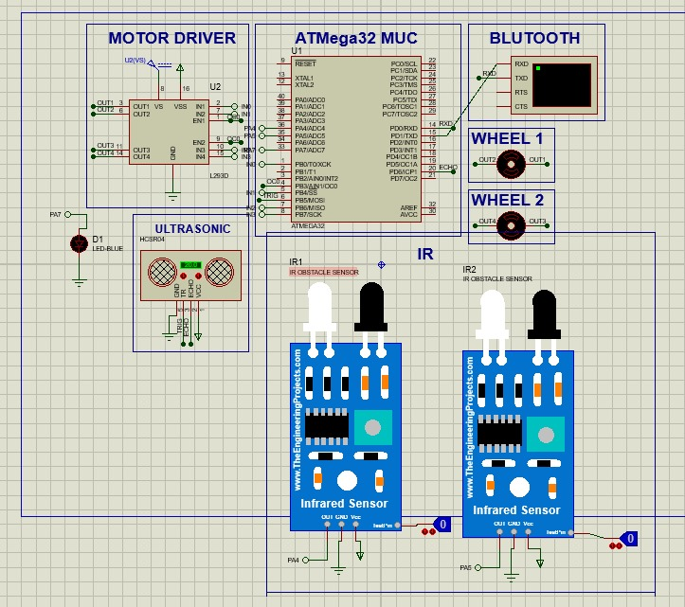
Simulation

Slide 8
Hardware Components
Title: Hardware Used in the Project
ATmega32 Microcontroller: Controls all components and processes.
Ultrasonic Sensor: Detects obstacles by measuring distance.
Bluetooth Module (HC-05): Enables wireless control through a smartphone.
DC Motors: Drives the car and allows for speed control.
Module H-Bridge L298: Controls the direction and speed of the DC motors, enabling forward and reverse movement.
IR Sensors: Used for line-following and path detection.

Slide 9
Ultrasonic Sensor
Function: Measures distance by emitting sound waves and calculating the time for them to return.
Components:
Transmitter: Emits sound waves.
Receiver: Receives reflected sound waves.
Use: Detects obstacles in the car’s path and triggers avoidance behavior (stopping or changing direction).
Placement: Mounted at the front of the RC car.

Slide 10
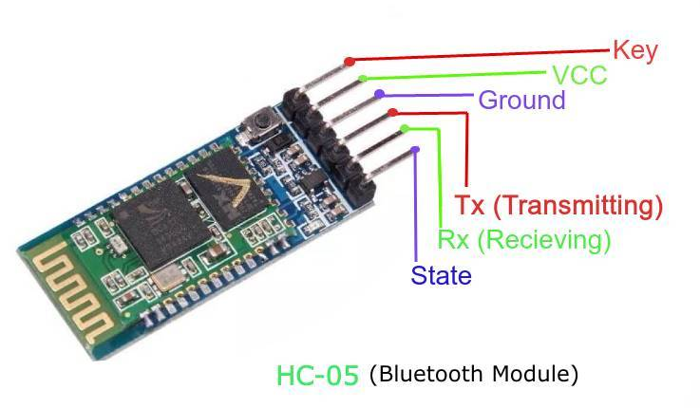
Bluetooth Module
Title: Bluetooth Module (HC-05) for Remote Control
Function:
Enables wireless communication between the RC car and a smartphone app.
Sends and receives commands to control the car.
Features:
Allows mode switching (autonomous/manual) through the smartphone app.
Controls speed and direction wirelessly.
Integration:
Communicates with the ATmega32 microcontroller to process the selected mode and execute the commands.

Slide 11
DC Motors
Title: DC Motors for Car Movement and Speed Control
Function: Drives the car and allows for precise speed control.
Features:
Controlled using Pulse-Width Modulation (PWM) for smooth acceleration and deceleration.
Provides sufficient torque for movement on various surfaces.
Components:
Two DC motors for forward and backward movement.
Servo motor (optional) for sharper turns.
Integration:
Connected to relays and transistors for directional control.

Slide 12
IR Sensors
Title: IR Sensors for Line-Following
Function:
Detects lines on the path using infrared light reflection.
Helps the car follow a predefined path accurately.
Features:
Differentiates between dark and light surfaces.
Provides precise path-tracking capability.
Integration:
Positioned at the bottom of the car for line detection.
Sends signals to the microcontroller for path guidance.

Slide 13
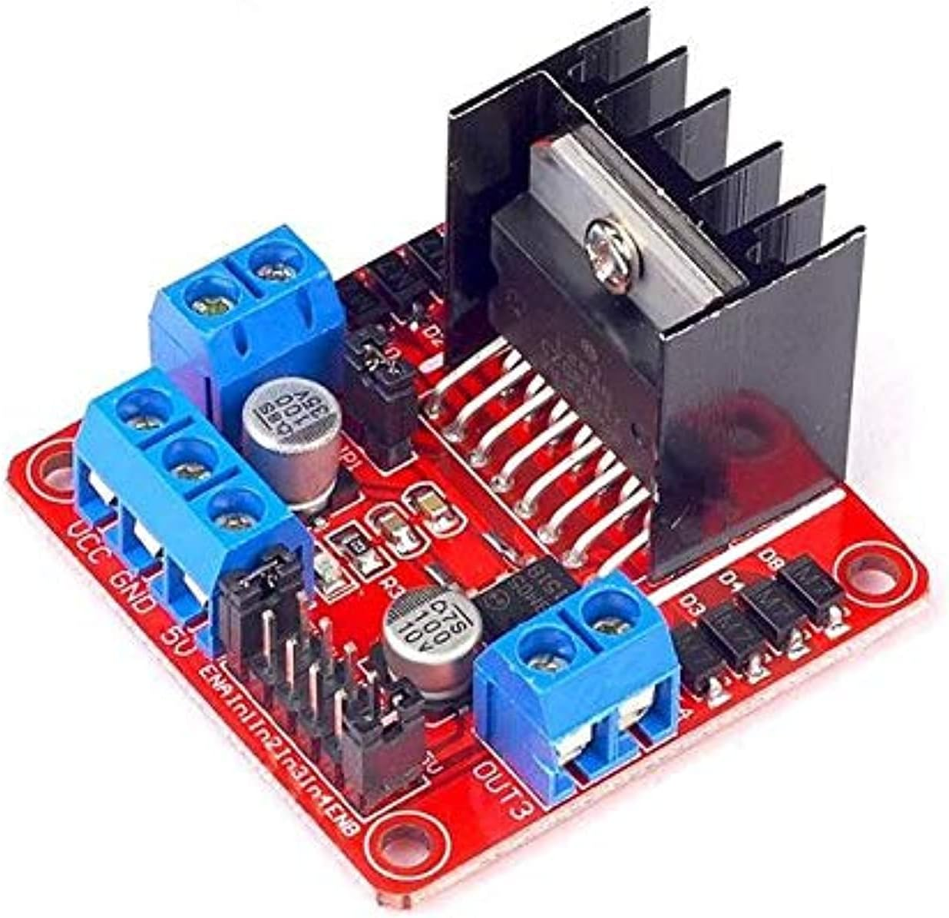
H-Bridge
Module H-Bridge L298
Function: The L298 module is used to control the speed and direction of two DC motors independently. It enables bidirectional movement, allowing the motors to rotate forward or backward.
Features:
Supports operating voltages from 5V to 46V.
Provides up to 2A of current per channel for motor control.
Can control two DC motors or one stepper motor.
Built-in protection diodes to safeguard against back EMF from motors.
Includes an onboard voltage regulator for logic circuitry.
Integration:
Receives control signals from the ATmega32 microcontroller to adjust the motor speed and direction.
Connected to the car's DC motors to manage forward, reverse, and braking actions.
Works seamlessly with other components, such as IR sensors and Bluetooth, to execute manual or autonomous modes effectively.

Slide 14
Implementation Steps
System Implementation Steps
Assemble all hardware components: sensors, motors, Bluetooth module, etc.
Develop and upload code to the microcontroller for line-following and obstacle avoidance.
Test each feature individually:
Ultrasonic sensor for obstacle detection.
Bluetooth control for manual operations.
IR to line Following
LED for displaying operational data.
Integrate all features into a complete system.
Conduct performance testing and fine-tune for accuracy and reliability.

Slide 15
Expected Results
Title: Anticipated Outcomes
The RC car will autonomously follow a predefined path.
It will efficiently detect and avoid obstacles in its path.
Seamless switching between autonomous and manual modes will be achieved.
Operational data such as speed and obstacle counts will be logged for future improvements.

Slide 16
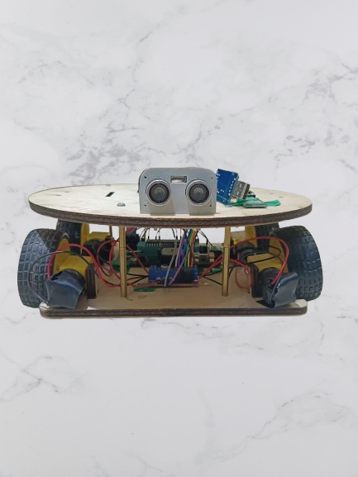
RC Car Picture
Title: Our Autonomous RC Car
This is the picture of our RC car prototype.
The design shows how we integrated the key hardware components:
Ultrasonic sensor for obstacle detection.
Bluetooth module for manual control.
DC motors for movement.
LCD for displaying status.
The car is capable of operating in both manual and autonomous modes.
Caption for the Picture (optional):
"Real-world implementation of our autonomous RC car project."

Slide 17
Manual Mode Control Instructions
In Manual Mode, you can control the car's movement via Bluetooth using a smartphone app. The available controls are:
Forward (Front): Moves the car straight ahead.
Right (Turn Right): Turns the car to the right.
Left (Turn Left): Turns the car to the left.
Backward (Back): Reverses the car

Slide 18
Line Following Mode
The RC car follows a predefined line on the ground using infrared sensors. The sensors detect the line's position, and the car adjusts its movement to stay aligned.
Key Features
Automatically tracks and follows a clear, continuous line.
Adjusts direction smoothly for accurate path-following.
Stops or adjusts if the line ends or an obstacle is detected.

Slide 19
Challenges
Title: Project Challenges
Integration Issues: Combining hardware and software components seamlessly.
Mode Switching: Ensuring smooth transitions between manual and autonomous modes.
Bluetooth Connectivity: Maintaining reliable communication with the car.
Accuracy vs. Simplicity: Balancing performance with system complexity.

Slide 20
Potential Enhancements
Battery Monitoring System:
Improved Line-Following:
Advanced Control Options:
Add a voltage sensor to monitor battery health and display the status on the LED or smartphone app.
Include a low-battery alert system.
Use an array of IR sensors for smoother and more precise path detection.
Implement PID (Proportional-Integral-Derivative) control for better line-following accuracy.
Use voice commands for manual control via the smartphone app.
Include gesture-based control using sensors like accelerometers.

Slide 21
Conclusion
The RC car successfully combines line-following using IR sensors, obstacle avoidance
with an ultrasonic sensor, and manual control through a Bluetooth module. It integrates
these systems with a microcontroller and includes data logging for performance enhancement.
Future Scope:
Add GPS for navigation.
Improve obstacle detection with advanced sensors.
Enhance mode transitions and accuracy with better algorithms.
Introduce camera vision and voice control for expanded functionality.

Slide 22

Thank You
Any Questions?

